Slide 1

SKIN CANCER DETECTION using Python and Keras
Team Members:
Abhishek Fulzele
Ayanjyoti Thakuria
Rahul Patel
Sourav Roy Choudhary

Slide 2
About the Dataset

Slide 3
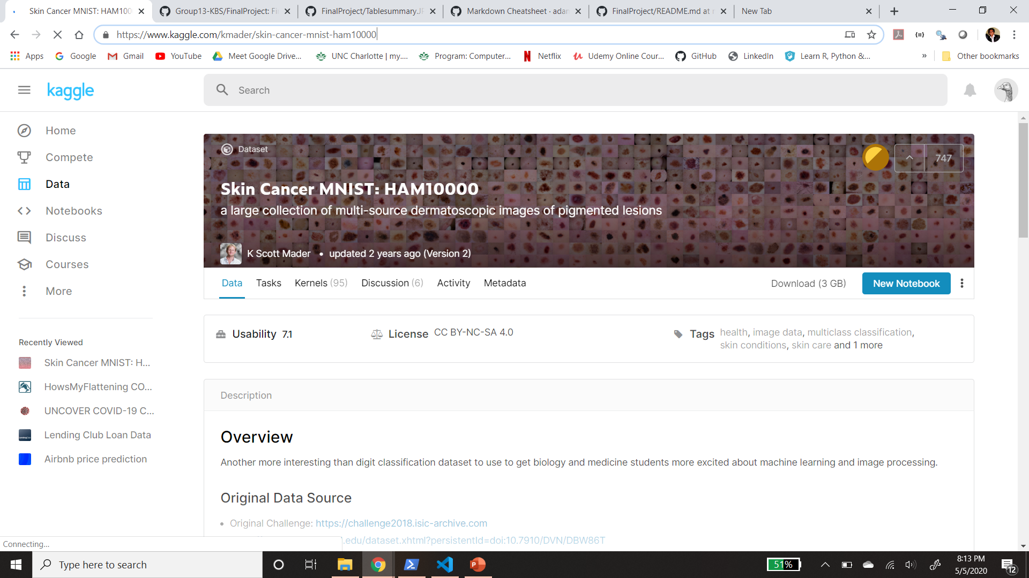
This file has 7 columns with 10015 rows which has information about patient details. In addition to this file we have 10015 images of various skin cancer patients.

Slide 4
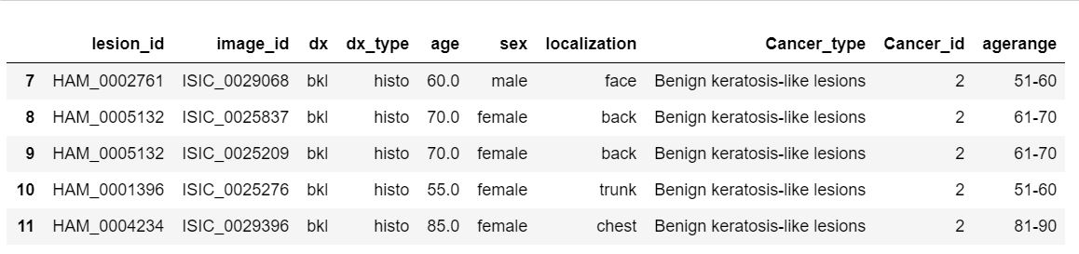
Metadata

Slide 5
Preprocessing of Dataset

Slide 6
Preprocessing: We have removed nulls from the age column and replaced it with the mean. We added 3 new columns in the table for better understanding of the data.
a) With dx - Cancer Type
b) With dx - type Cancer Id
c) Age Range - Age - For Plotting age Data

Slide 7
Exploratory Data Analysis

Slide 8
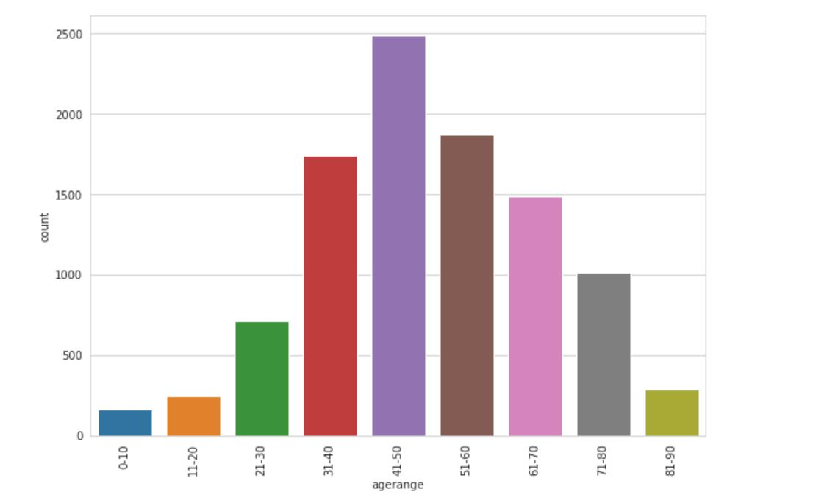
Representing count of each age range

Slide 9
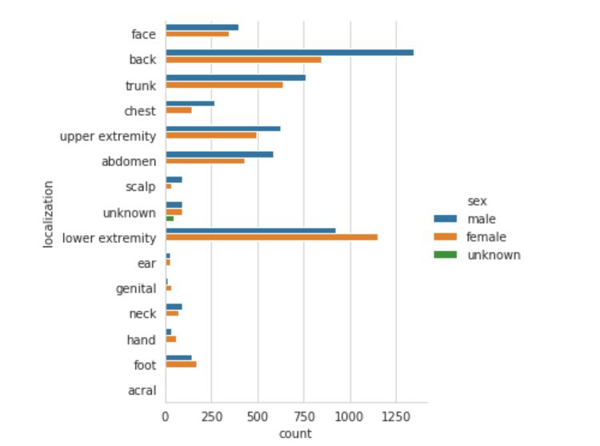
Representing body part affected based on gender

Slide 10

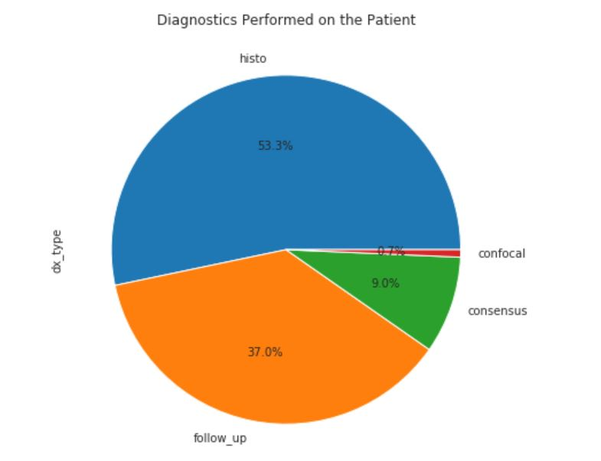

Representing pie chart of diagnostics type

Slide 11
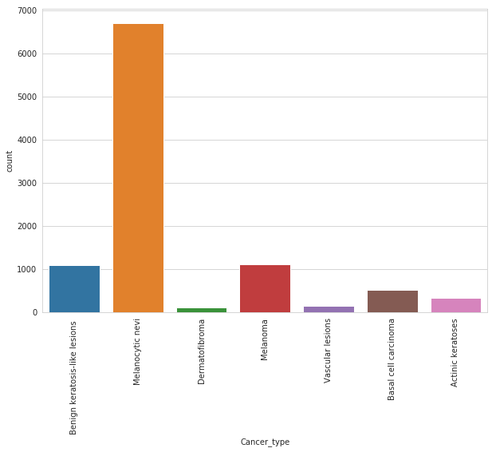
Representing cancer type and their counts

Slide 12
Building a Predictive Model

Slide 13
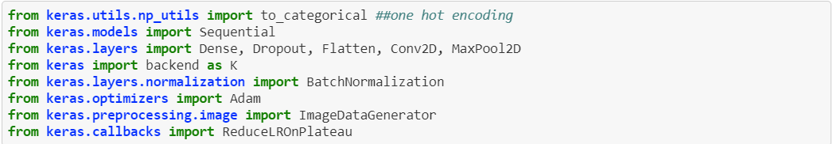
Python libraries from Keras to built predictive model

Slide 14
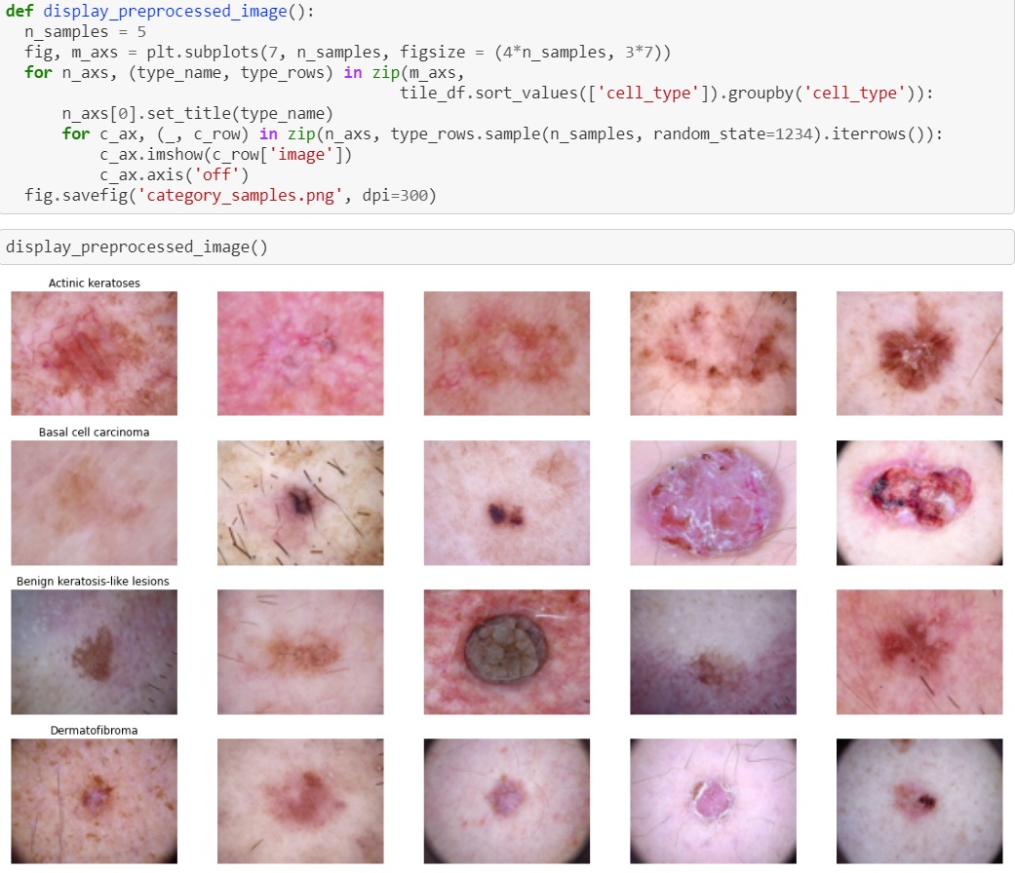

Slide 15
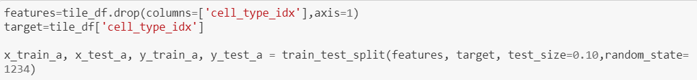
Splitting Training and Testing Dataset in 10/90 ratio

Slide 16
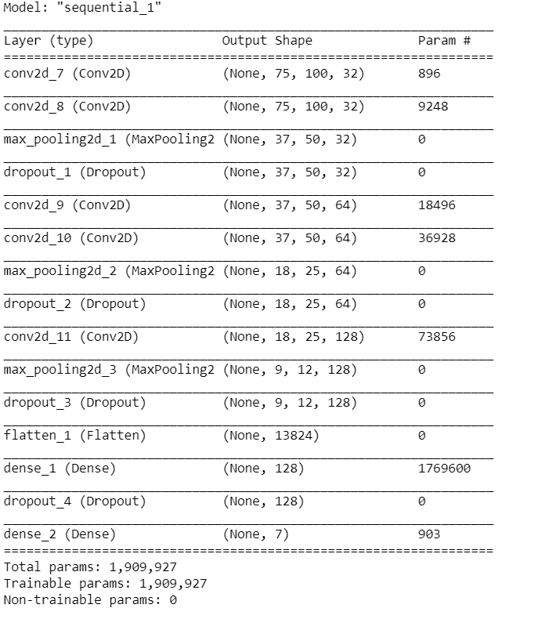
Model Summary

Slide 17
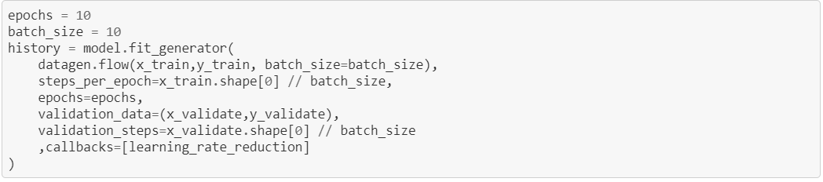
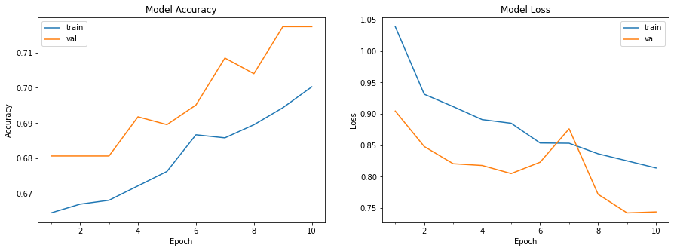
Model Accuracy
Model Loss

Slide 18
Thank You

